Slide 1
Topic 2 - Computer Architecture
IB Computer Science

Slide 2
What is computer architecture?
What is going on “under the hood”
Focus on how different components work together
CPU
Storage
OS

Slide 3
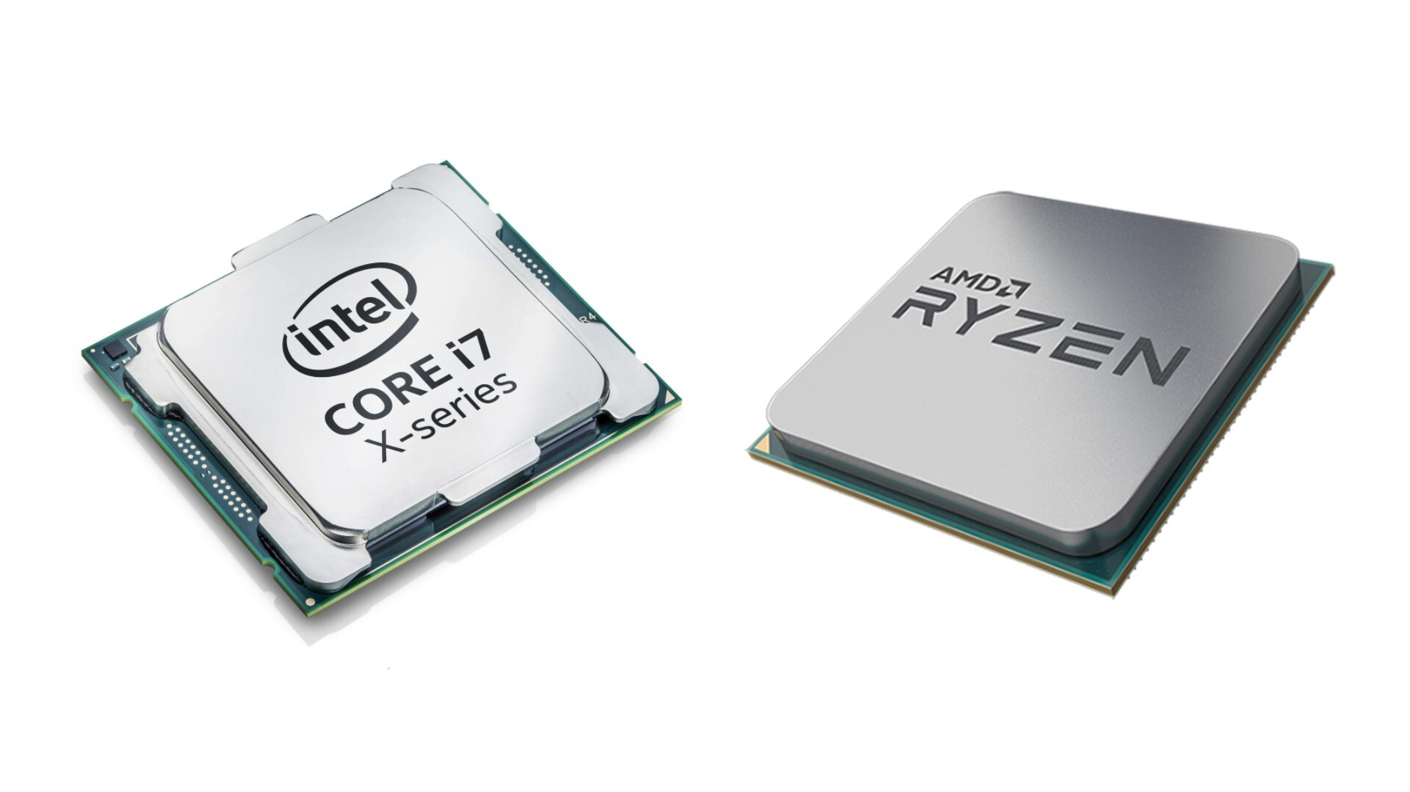
CPU (Central Processing Unit)
“The Brain”
Processing all instructions
Code is executed here
Arithmetic, logical, input/output operations

Slide 4
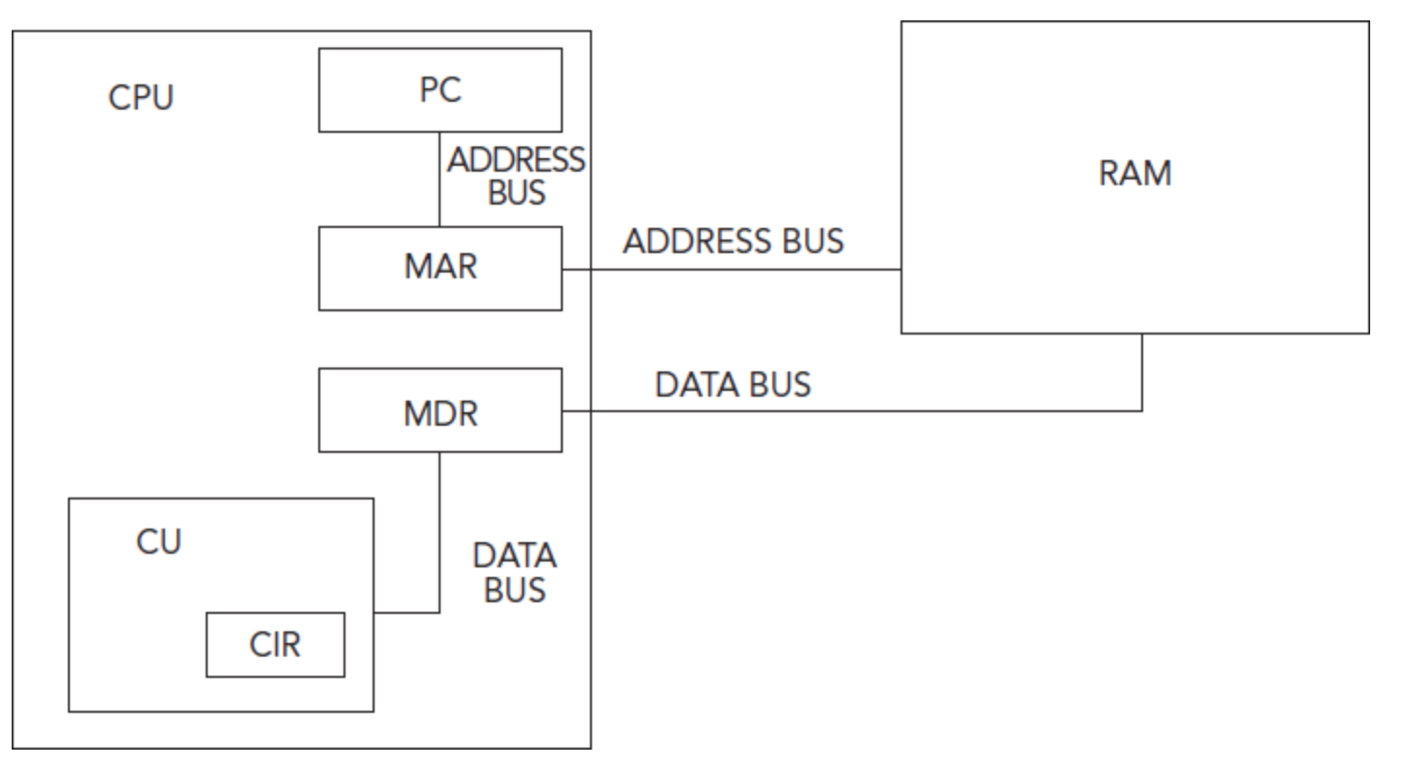
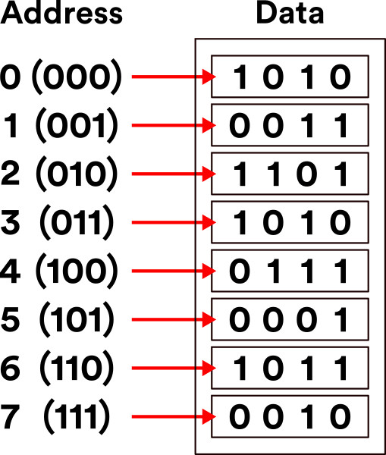
CPU (Von Neumann Model)
ALU
ACC

Slide 5
Fetch-Decode-Execute Cycle (FDE Cycle)
Process starts at the PC
PC sends the next address to be checked to the MAR
MAR sends address to RAM, stores result in MDR.
MDR sends data to the CIR (Current Instruction Register) for decoding.
CIR passes the decoded instructions on to the ALU, which does everything that’s needed to be done.
ALU gives address to MAR if it needs and further instructions.

Slide 6
Fetch-Decode-Execute Cycle (FDE Cycle)
PC → MAR
MAR → RAM
RAM → MDR
MDR → CIR/CU
CU → ALU
ALU → output
Fetch 1)-3)
Decode 4)
Execute 6)
PC = Program Counter
MAR = Memory Address Register
RAM = Random Access Memory
MDR = Memory Data Register
CU = Control Unit
ALU = Arithmetic Logic Unit

Slide 7
Notes on CPU/FDE Cycle
FDE cycle orchestrated by Control Unit (CU)
2 cores = 2 ALUs
Processor Speed = # of FDE Cycles per second
2GHz = 2 billion cycles per second
FDE Cycle = Machine-Instruction Cycle

Slide 8
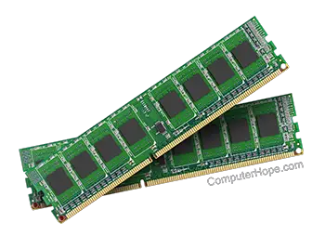
Primary Memory (RAM)
Random Access Memory
“Short term memory”
Address → Data
Volatile - data lost when computer turned off
Non-persistent storage

Slide 9
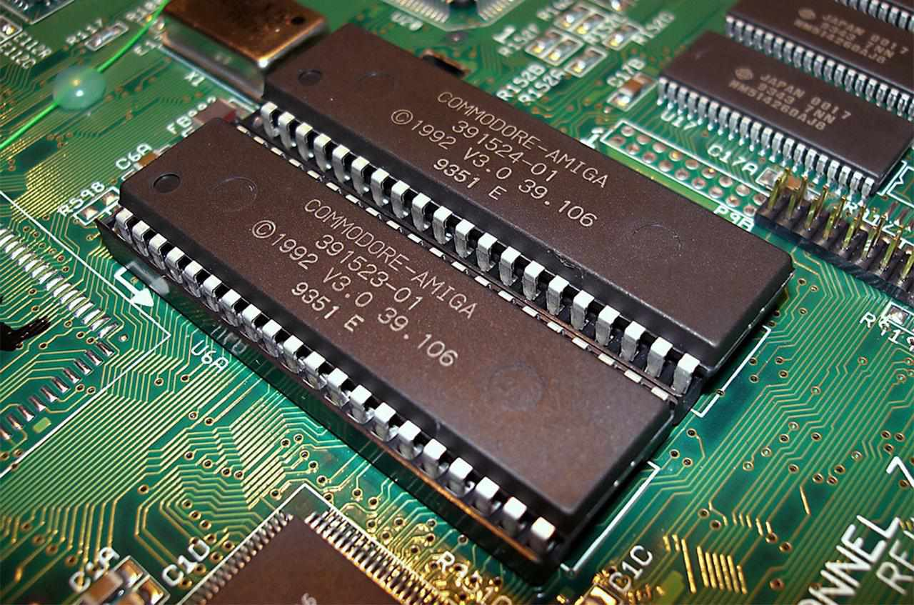
Primary Memory (ROM)
Read-only Memory
Used to store permanent instructions
Instruction to boot computer (BIOS)
Instructions written in factory
Keeps data without electricity

Slide 10
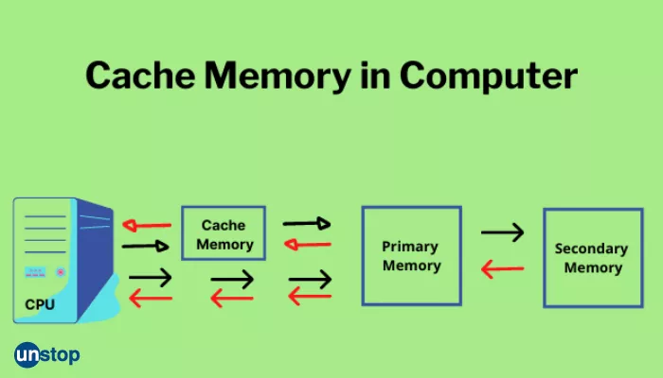
Cache
Stores frequently used instructions from RAM
Processor checks cache first
L1 (Fastest) and L2 Cache
Cache memory more expensive

Slide 11
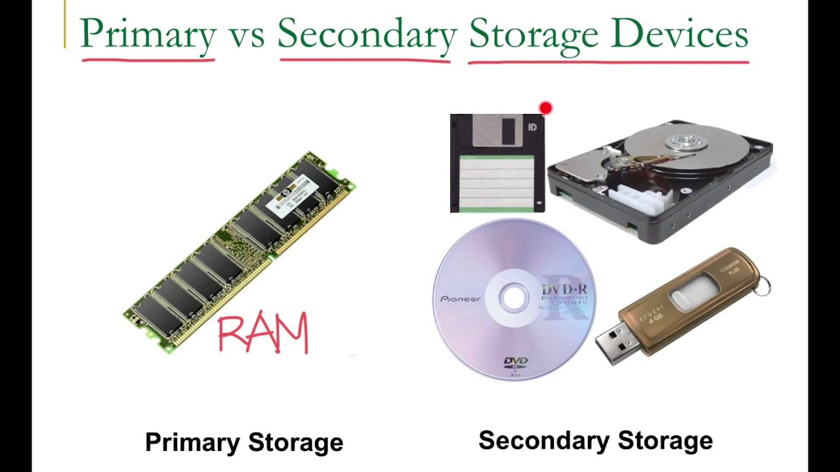
Secondary Memory
Hard Drive
“Long-term Memory”
Persistent storage
Holds all data not currently in use
Data for running programs transferred from secondary to primary memory
Slower and cheaper than primary
Not directly connected to CPU
Much larger amounts

Slide 12
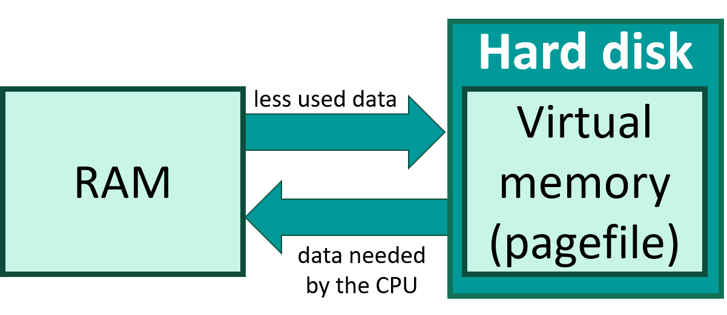
Virtual Memory
When primary memory overloaded, data sent to secondary
Slower
Temporary
Returned to primary memory as needed
Stored in units called “pages”

Slide 13
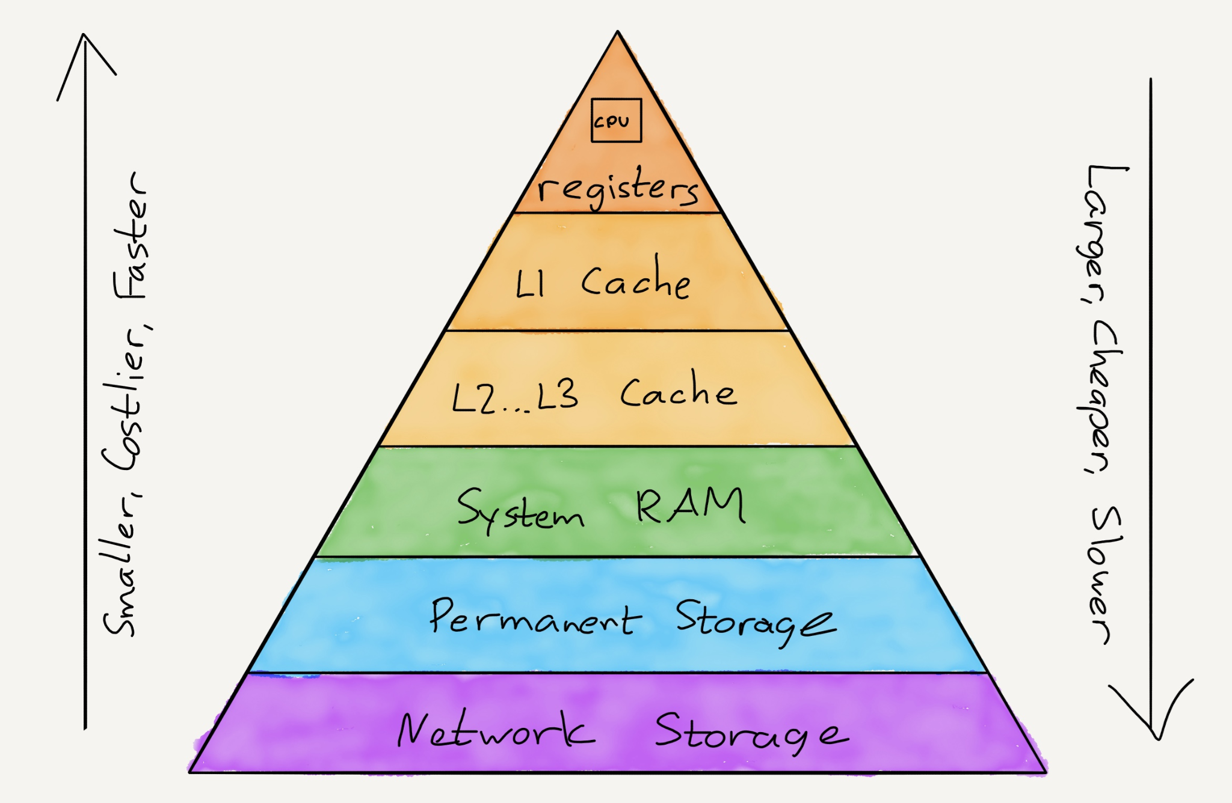

Slide 14
Operating System

Slide 15
Operating Systems
“set of software that controls computer’s hardware and resources and provides services for computer programs”
5 roles
User interface
Memory Management
Peripheral Management
Multitasking
Security

Slide 16
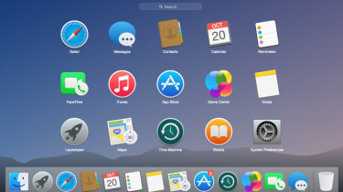
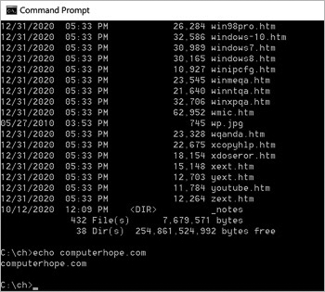
User Interface
Link between user and hardware
4 types of UI
GUI (Graphical User Interface) - menus, point and click
CLI (Command Line Interface) - type in commands
NLI (Natural Language Interface) - speak to computer (Siri)
MBI (Menu Based Interface) - Like CLI, but no commands, only menu option

Slide 17
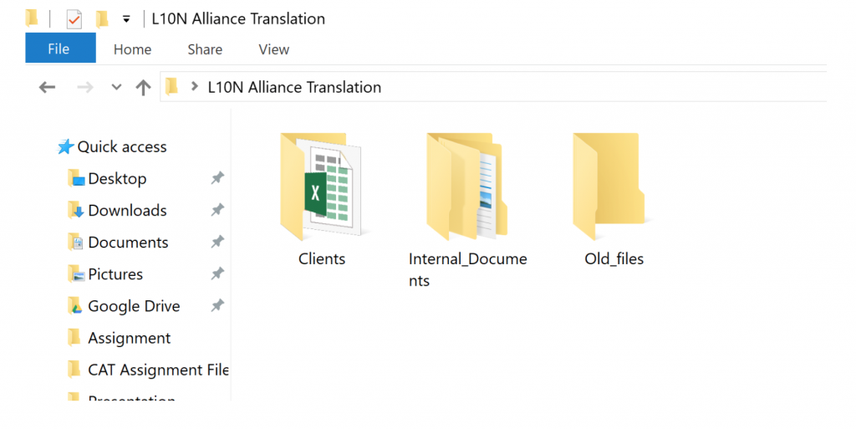
Memory Management
Keep track of storage devices (HDD, Flash Drive)
Allocate memory (RAM) to programs
Modify memory locations
Sort data on disk drives and RAM for efficiency
Organize data into folders
Copy and delete files

Slide 18
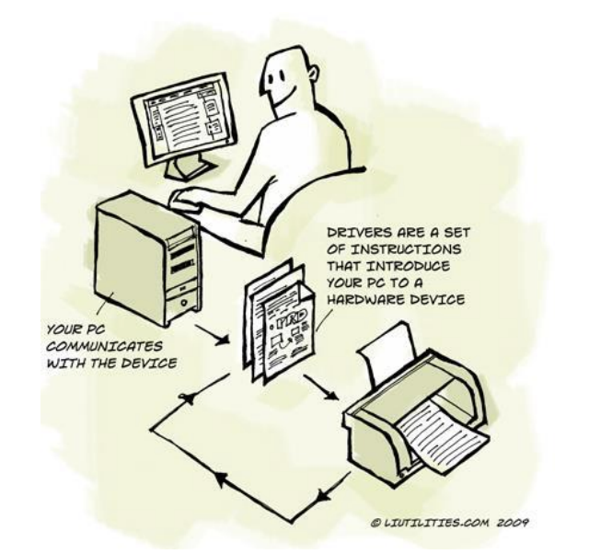
Peripheral Management
Peripherals - keyboard, mouse, monitor, etc.
Coordinate with BIOS (basic input/output system)
Use device drivers to interface with peripherals
Device drives translate peripheral signal

Slide 19
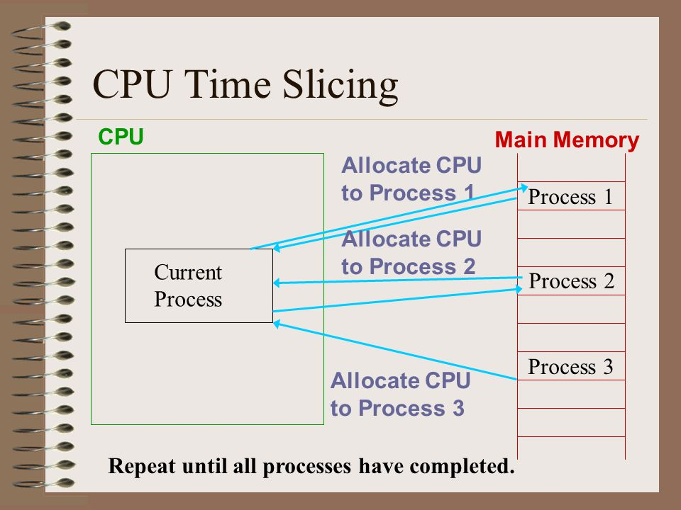
Multitasking
Allocates CPU cycles to concurrent programs based on priority and time
Each program given a slice of time, or a “turn” to use CPU
Slices vary in length of time

Slide 20

Security
Username and password
User permissions
File permissions for reading and writing

Slide 21
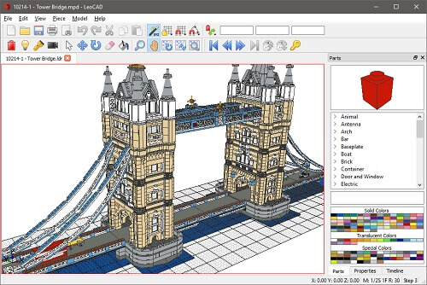
Application Software
Word Processors
Spreadsheets
Database Management System (DBMS) (MS Access)
Email Client (Outlook)
Web Browser
Computer Aided Design (CAD)
Graphic Processing Software (Photoshop)

Slide 22
Data Representation

Slide 23
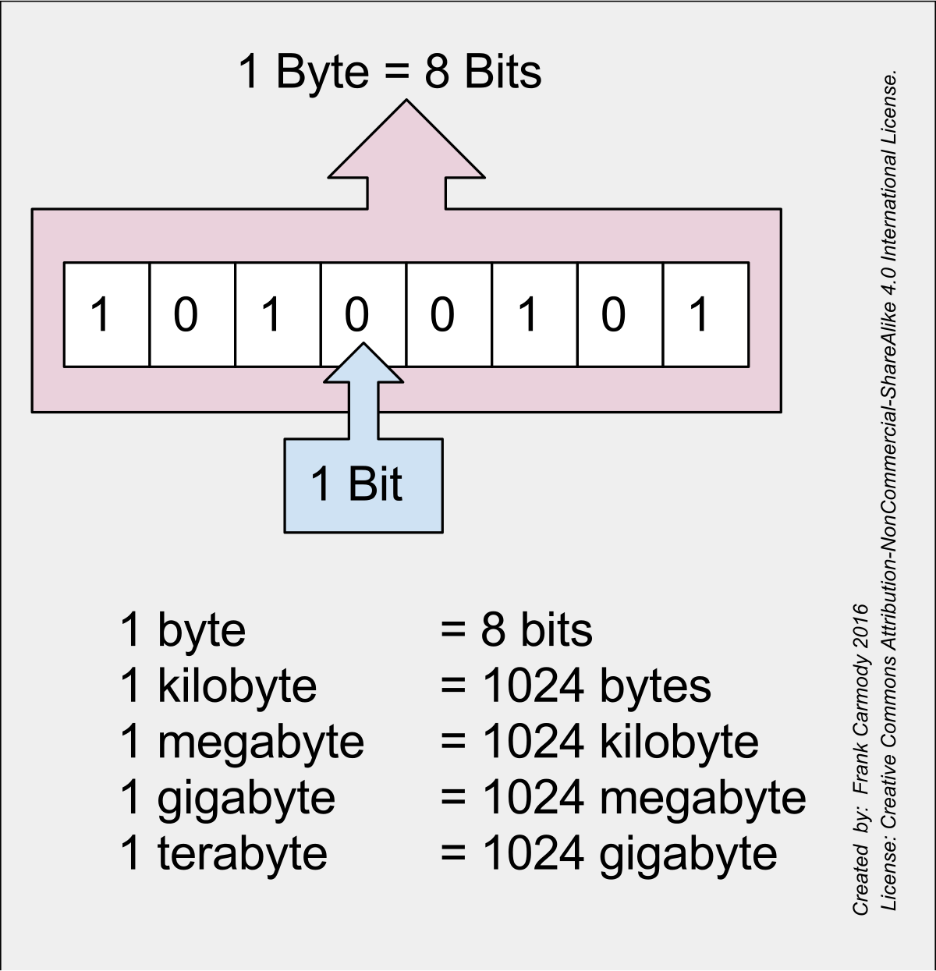
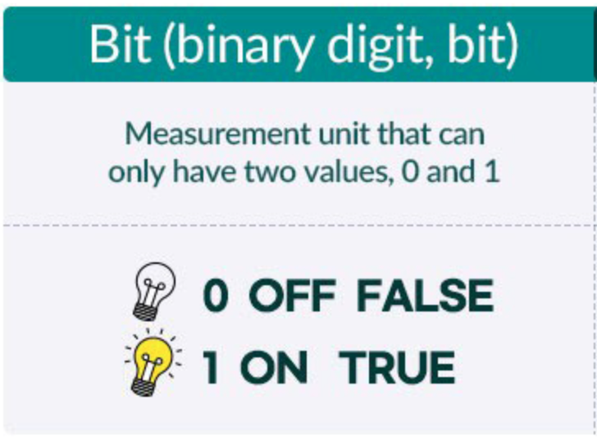
Bits and Bytes

Slide 24
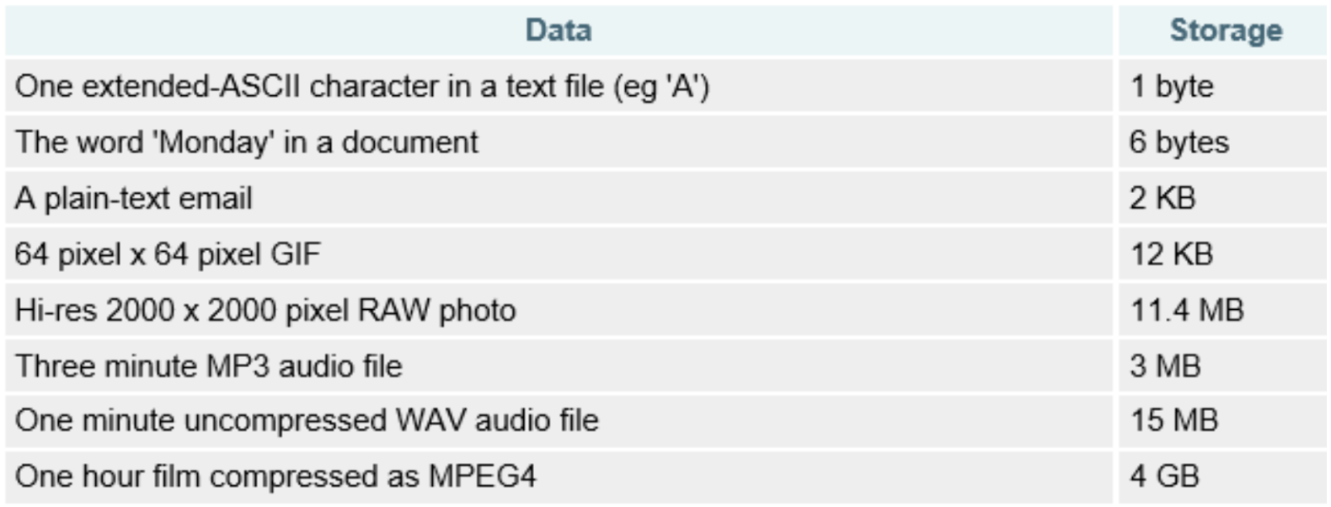

Slide 25
Binary
Language of the CPU and modern computing
1, 0
Base 2

Slide 26
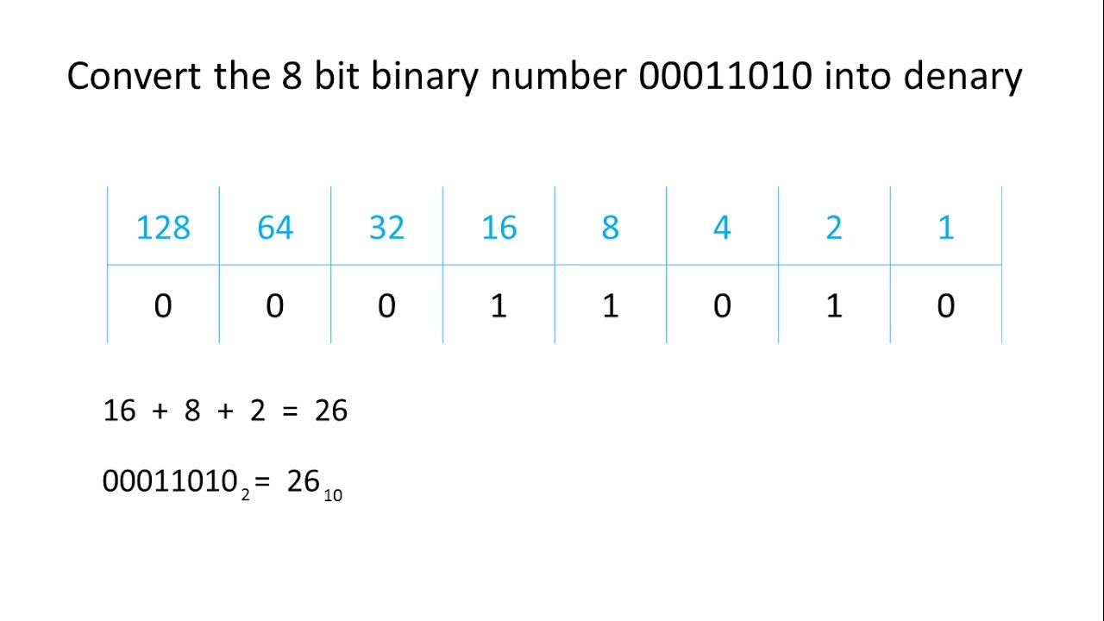
Binary→Denary

Slide 27
Examples
11101001→233
10001101→141

Slide 28
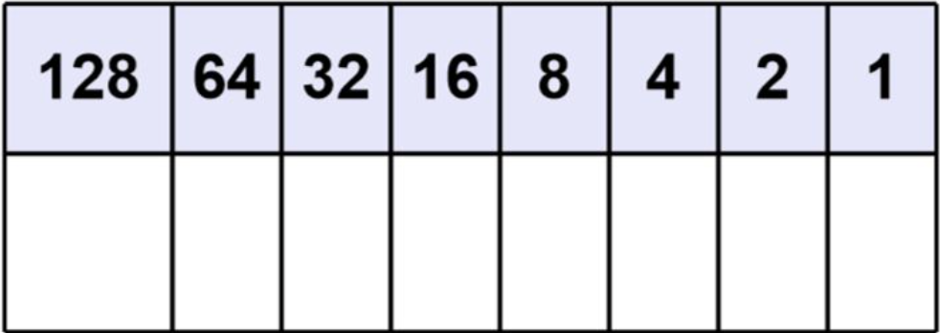
Denary→Binary

Slide 29
Examples
168→10101000
83→01010011

Slide 30
Hexadecimal
More efficiently represents large binary values
Colors
Memory addresses (esp. in assembly)
MAC Addresses
Base 16

Slide 31
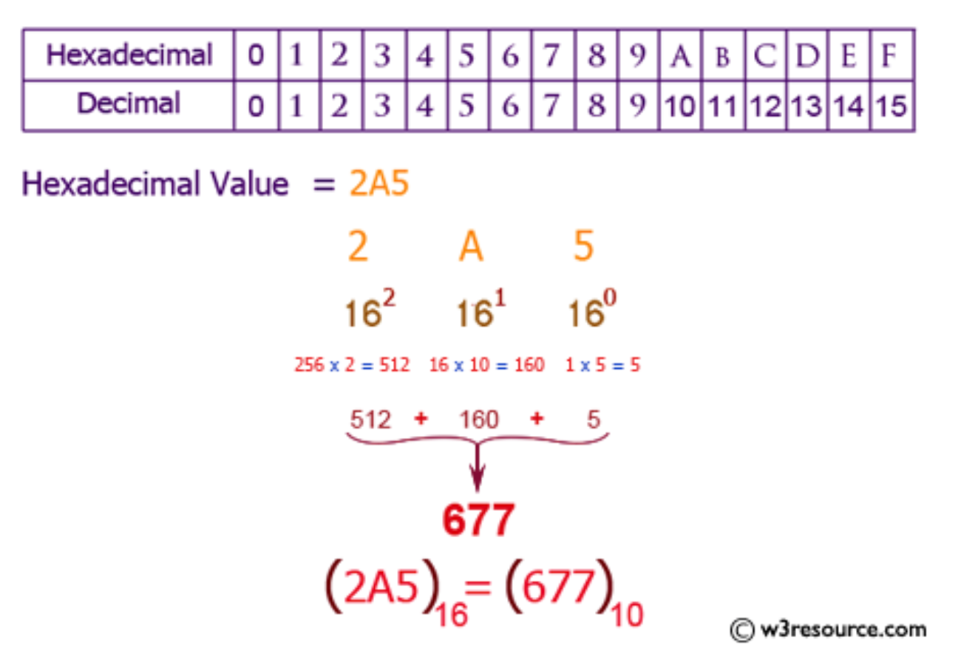
Hexadecimal→Denary

Slide 32
Examples
3B → 59
18E → 398

Slide 33
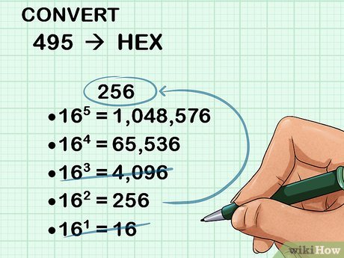
Denary→Hexadecimal

Slide 34
Examples
480 → 1E0
232 → E8

Slide 35
Hexadecimal ↔ Binary
Each hexadecimal digit represents 4 binary bits
111011 → 3B
11010110 → D6
92 → 10010010

Slide 36
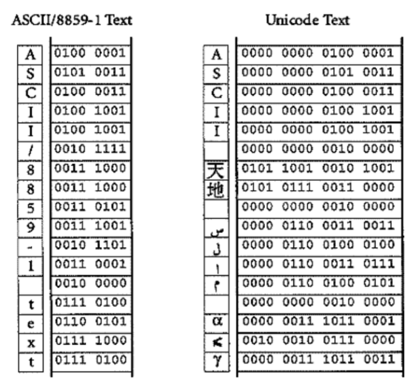
How is text displayed?
Strings are made up of characters
Each character is represented by a certain number of bytes
Two formats: ASCII and Unicode

Slide 37
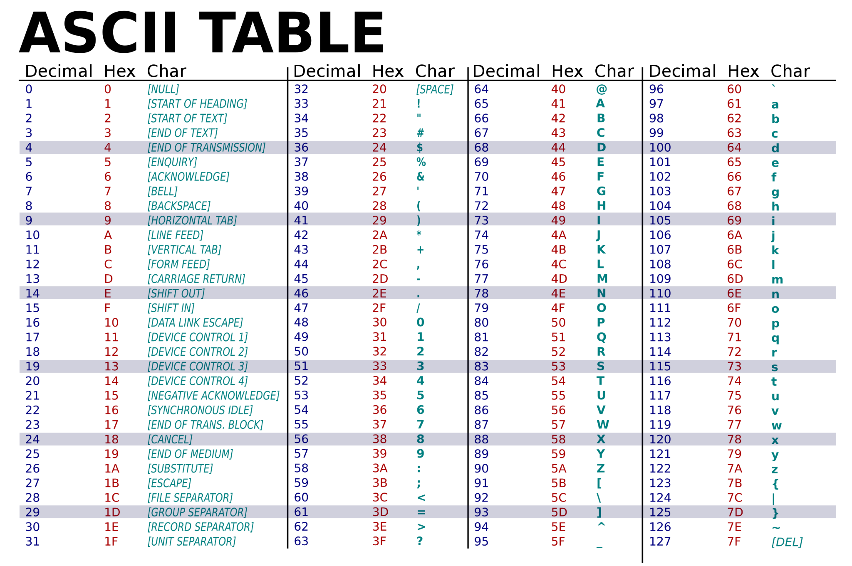
ASCII
Use 8 bits for each character
7 bits used for each character, 1 bit is parity bit
2^7 or 128 possible characters
Lower case, capitals, numbers, symbols, spaces, punctuation included

Slide 38
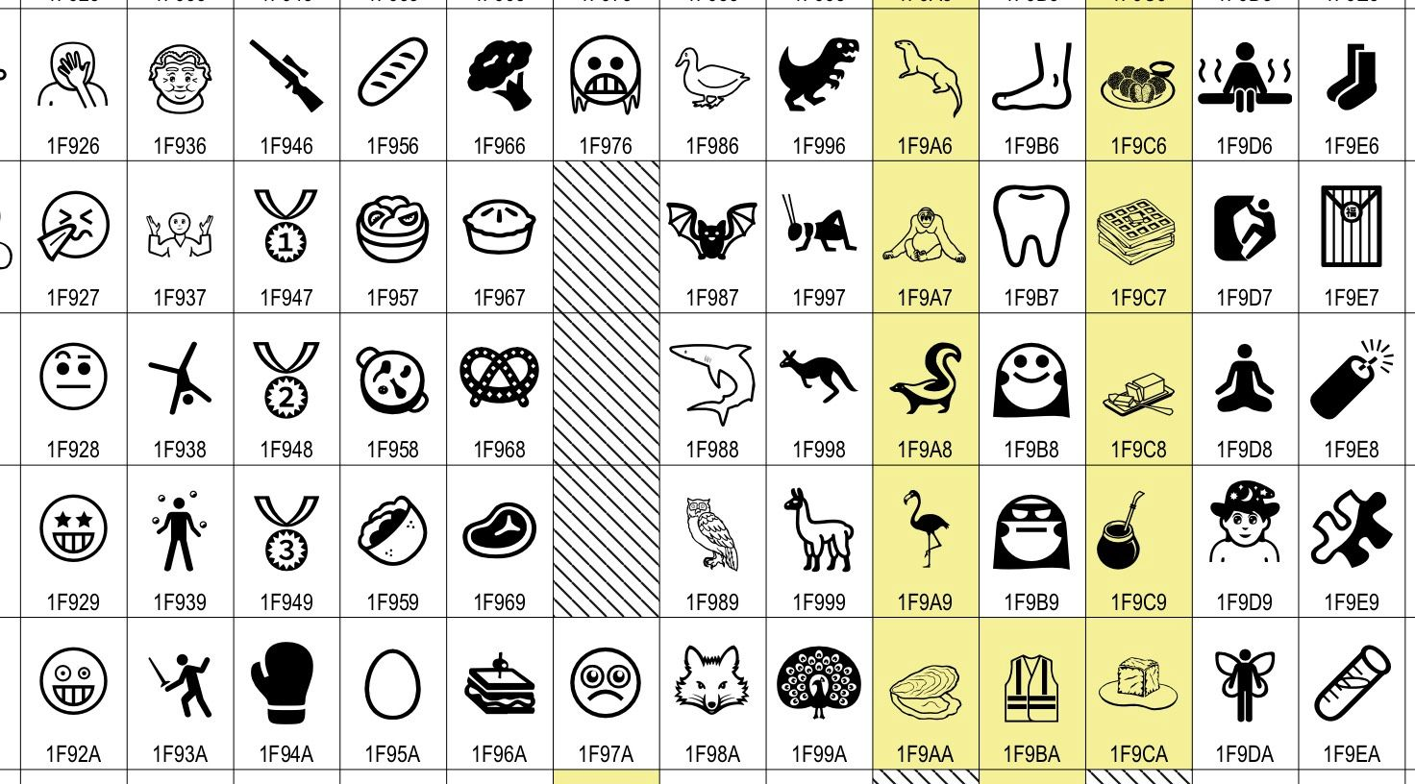
Unicode
Used to represent multiple languages
More bits, so more characters can be represented
UTF-8 → 8 bits
UTF-16 → 16 bits
UTF-32→32 bits

Slide 39
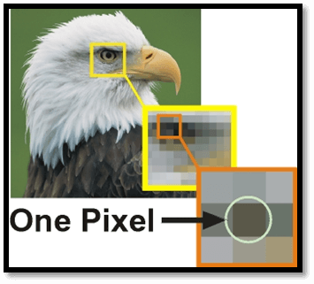
How are images displayed?
Each display (monitor, phone screen, etc.) is divided into pixels
pixel = “little square” in grid
pixel = smallest controllable element in display
Each pixel has a different color
Each pixel has one color at one moment
The color is combination of red, blue and green
Pixels together display image
1024x764 screen resolution →1024 pixels high, 764 wide
1080p, HD, 4K refers to number of pixels in screen

Slide 40
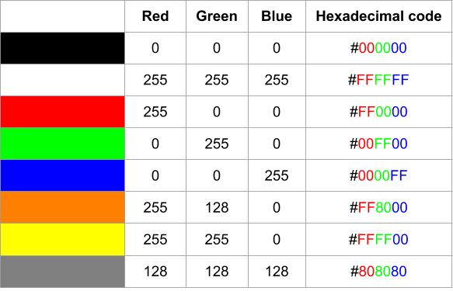
Pixels
Each color in each pixel represented by 6 digit hexadecimal value( Ex: 70EF5A)
First two values represent red, second two represent green and last two represent blue (Ex:70EF5A)
16^2*16^2*16^2 = 256*256*256 possible color combinations

Slide 41
Logic Gates

Slide 42
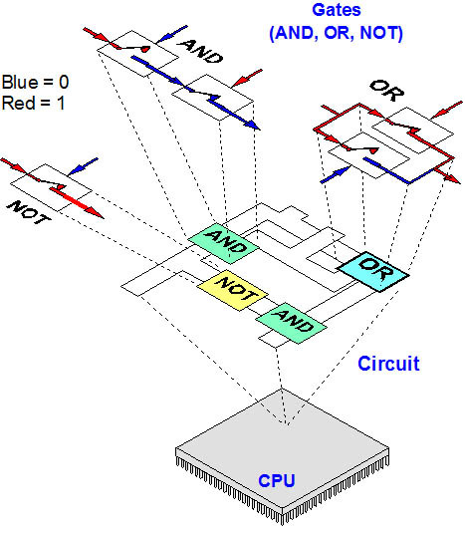
Logic Gates
Processors/chips made up of millions of “switches” called logic gates
Each logic gate takes 1-2 inputs and 1 output
Possible inputs are 1 or 0
1 = high voltage, 0 = low voltage
Voltage = “pressure that forces charged electrons” to flow through circuit

Slide 43
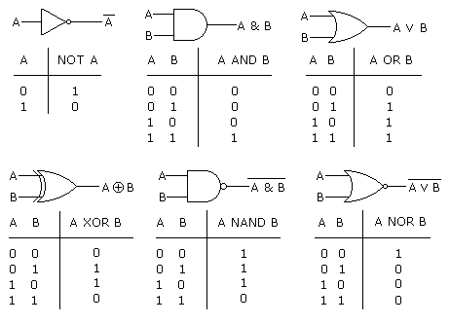

Slide 44
Examples
X OR NOT Y
(A XOR B) AND NOT C
(A OR B) AND NOT(A AND C)

Slide 45
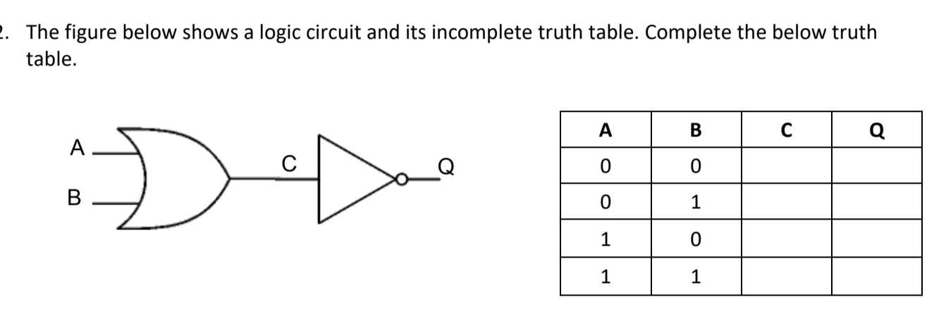

Slide 46
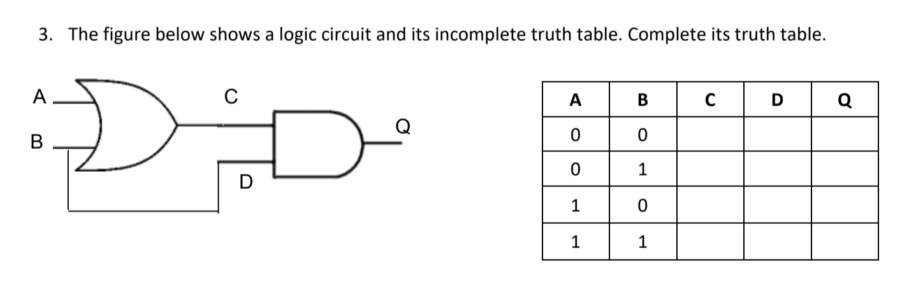

Slide 47
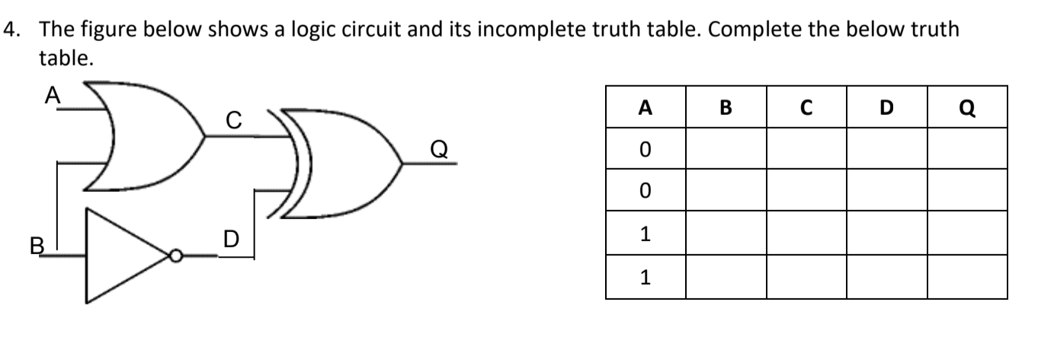

Slide 48
IB Questions

Slide 49
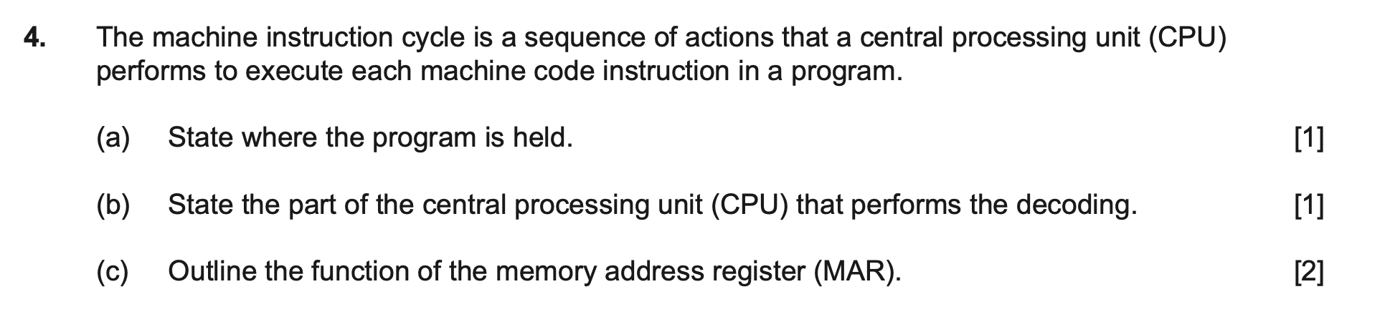

Slide 50
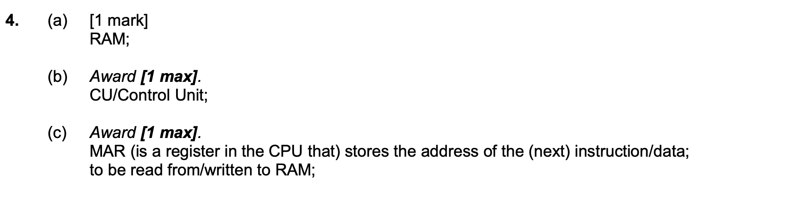

Slide 51
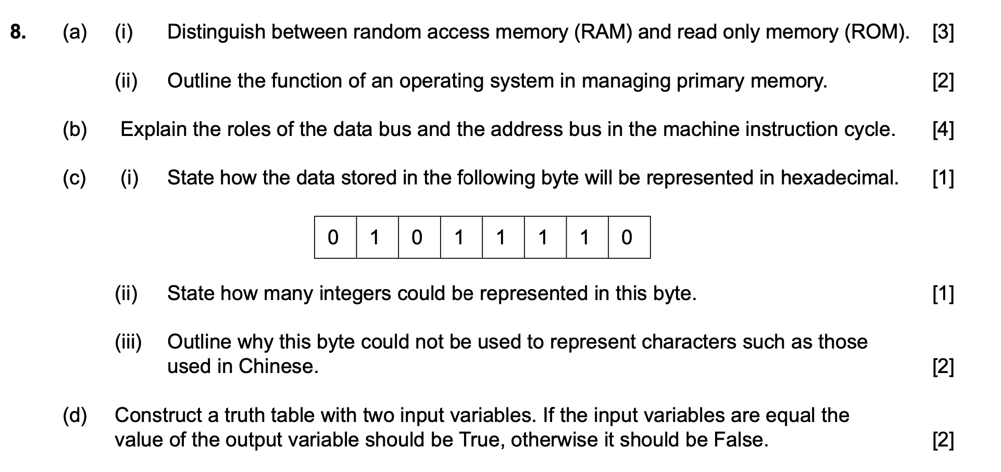

Slide 52
Answers
https://drive.google.com/file/d/1SzuKvNN7ybuq7jsR4C9pBF4i6xHxUiOq/view?usp=sharing

Slide 53
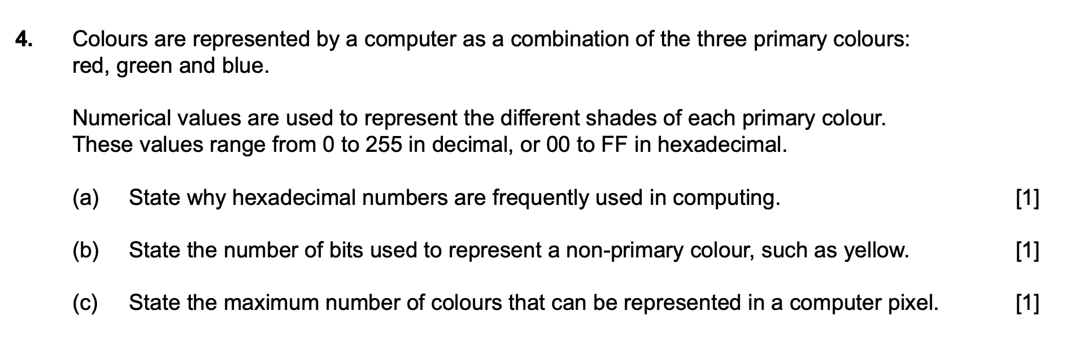

Slide 54
